Slide 1
Self-Formed Catalysts Using Electrochemical (de)Lithiation for Oxygen Evolution Reaction
Vaidish Sumariaª, Dilip Krishnamurthy^{b}, Venkat Viswanathan^{a,b}
ªDepartment of Chemical Engineering, Carnegie Mellon University
^{b}Department of Mechanical Engineering, Carnegie Mellon University

Slide 2
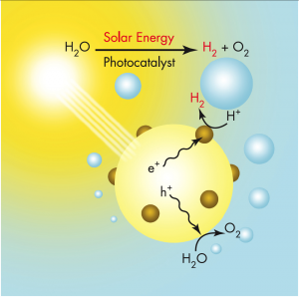
Introduction
Solar Energy – Inexhaustible Natural resource
Oxygen evolution reaction – Key process in enabling solar driven water splitting.
SOFC
PEMFC
Notes:
Harvesting energy directly from sunlight offers a desirable approach to fulfill the need for clean energy.
Our ability to split water and use Polymer electrolyte membrane cells or solid oxide fuel cells to produce electricity is limited by the activity of the catalysts for oxygen and hydrogen evolution. In this talk I will be focusing on Oxygen evolution reaction catalysis.

Slide 3
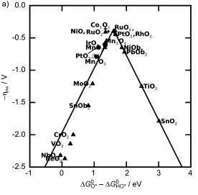
Current Scenario
IrO₂ and RuO₂ – among the most active catalysts
Material Scarcity
High cost
Lee Y. et. al. J. Phys. Chem. Lett., 2012, 3 (3), pp 399–404
Man I.C. et. al. ChemCatChem 2011, 3, 1159 – 1165
Notes:
Currently Ruthenium dioxide and Iridium dioxide are known to be the most active catalysts for Oxygen evolution reaction.
Although their high cost and low abundance, makes them unusable on a large industrial scale.
This motivates us to find a new class of materials apart from the well known rutile oxides and perovskites that are cheap and abundant to replace these precious metal based catalysts.
Higher res possible for right figure?

Slide 4
Reaction Mechanism for Oxygen Evolution Reaction
$2H_{2}O\left(l\right){→O}_{2}\left(g\right)+4H^{+}+4e^{−}$($ΔG_{rxn}=4.92 eV$)
Associative mechanism
H₂O (l) + * → OH* + H⁺ + e⁻ ($ΔG_{1})$
OH* → O* + H⁺ + e⁻ ($ΔG_{2})$
O* + H₂O (l) → OOH* + H⁺ + e⁻ ($ΔG_{3})$
OOH* → * + O₂ (g) + H⁺ + e⁻ ($ΔG_{4})$
Calculated using DFT
$$∆G= ∆E −T∆S+ZPE$$
$$E\left(H^{+}\right)+E\left(e^{−}\right)=\left\{−\frac{kT}{2}ln\left(10\right)×pH\right\}+\left\{−eU\right\}+\left\{\frac{1}{2}×E\left(H_{2}\left(g\right)\right)\right\}$$
Man I.C. et. al. ChemCatChem, 2011, 3, 1159 – 1165
Notes:
1. Let us now first discuss how Oxygen evolution is modelled using Density function theory.
2. The reaction involves oxidation of of water to oxygen with formation of 4 protons and 4 electrons.
3. We assume a associative mechanism that involves sequential production of proton and electron in each elementary step. The free energy change in each elementary step is given as G1 G2 ,etc.
4. The free energy of a proton and electron can be referenced to the Standard Hydrogen Electrode and can be written as shown.
5. The free energies of the intermediates OOH, O and OH along with Hydrogen and Water can be calculated using DFT
6. Lastly as DFT is known to not treat the oxygen molecule accurately, the free energy of O2 is calculated using the free energy of the overall reaction. (point mouse to 4.92 eV)
Remove these colored boxes completely. You can underline through an animation if you want. Since this is pretty well established, you can use pointer to show these things. They’ll think you are new to the field otherwise.

Slide 5
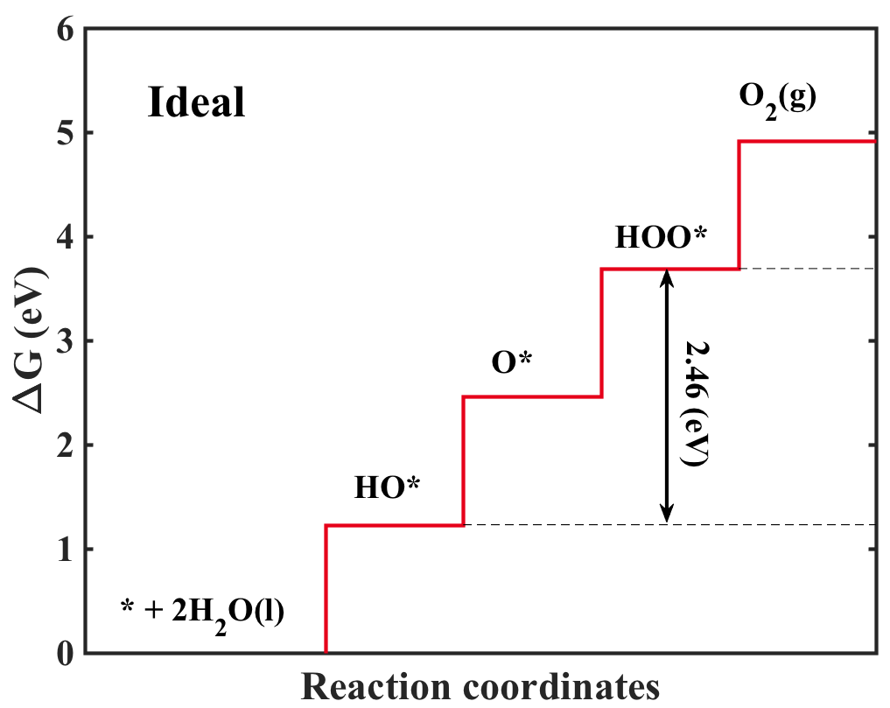
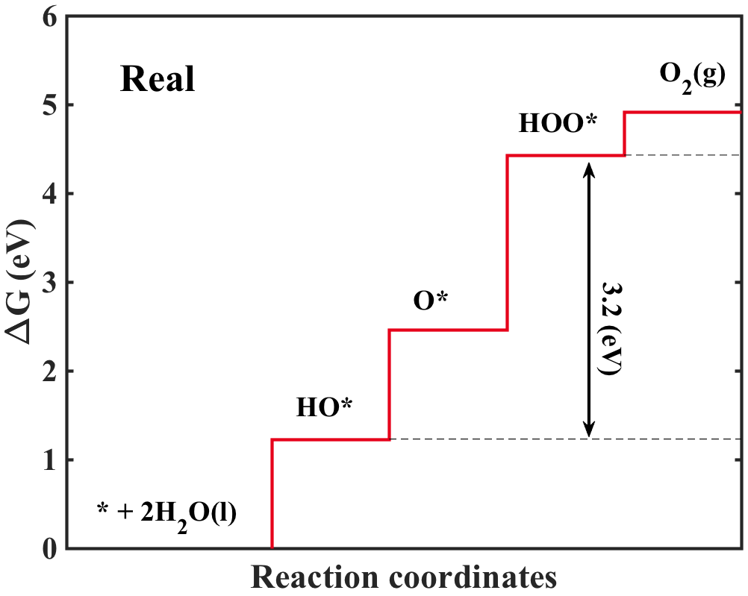
Potential Determining Steps
Potential determining step - last step to become downhill in free energy as the potential increased.
$$G^{OER}=\max{[ ∆G_{1}^{0},∆G_{2}^{0},∆G_{3}^{0},∆G_{4}^{0}]}$$
Scaling relation : $ΔE_{OOH}= ΔE_{OH}+3.2 (eV)$
$G^{OER}=\max\left[∆G_{2}^{o}, ∆G_{3}^{o}\right]=$ max[$\left(∆G_{2}\right)$, 3.2-$\left(∆G_{2}\right)$]
= max[$\left(∆G_{3}\right)$, 3.2-$\left(∆G_{3}\right)$]
Descriptors ($∆G_{2})$ or ($∆G_{3})$ can be used as the single descriptor to predict limiting potential.
Notes:
The figure shows a free energy diagram for an ideal catalyst, one that would have maximum activity. In such a case each of the elementary steps would have a free enrgy change of 1.23 eV.
The potential determining step is the last elementary step to become downhill in free energy as potential is increased.
In other words, for the case of Oxygen evolution reaction, it can be represented as the maximum of the free energies of the intermediate steps.
For real catalysts, the difference between the free energy of adsorbed OOH and adsorbed OH, is almost constant is approximately equal to 3.2. This linear scaling between the adsorption energy can be reasoned by bond order conservation principles.
This the limiting potential for the reaction can be expressed in terms of one variable either \delta G_2 or \delta G3
An important thing that emerges from this analysis is that, by tuning the adsorption characteristics of the various intermediates, the activity of the material for oxygen evolution reaction can be changed.
Single descriptor ($∆G_{2})$ or ($∆G_{3})$ can be used as the single descriptor -- twice single descriptor

Slide 6
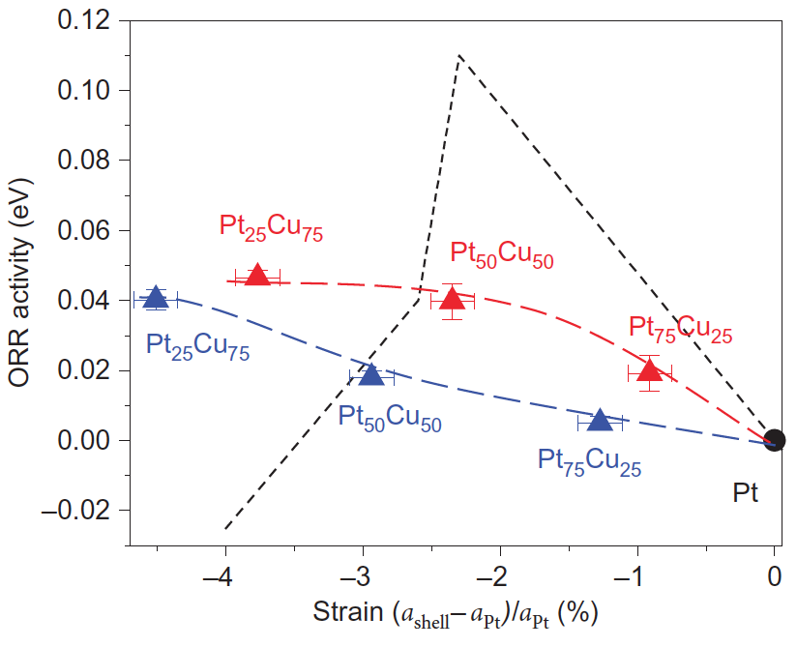
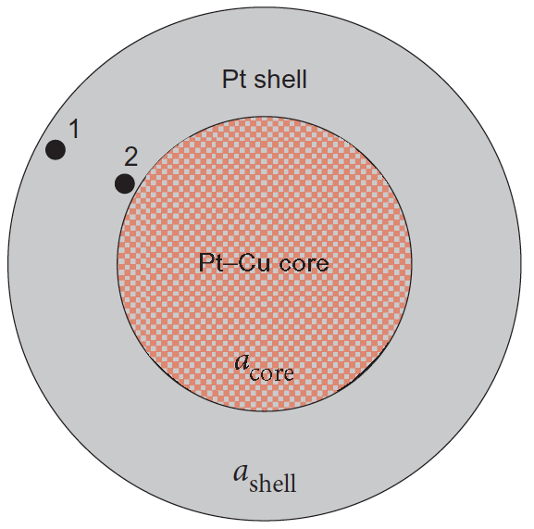
Tuning the Adsorption Characteristics
Strain
Strasser P. et. Al., Nature Chemistry, 2010, 2, 454–460
Notes:
A lot of mechanisms have been used to tune the energetics of the adsorbed intermediates. Few of these mechanisms include
Strain – Here you can see that lattice strain was used as a method for to control the activity in de-alloyed core-shell fuel cell catalysts. X axis shows the strain with respect to bulk Platinum lattice. As the strain increases, activity increases too.

Slide 7
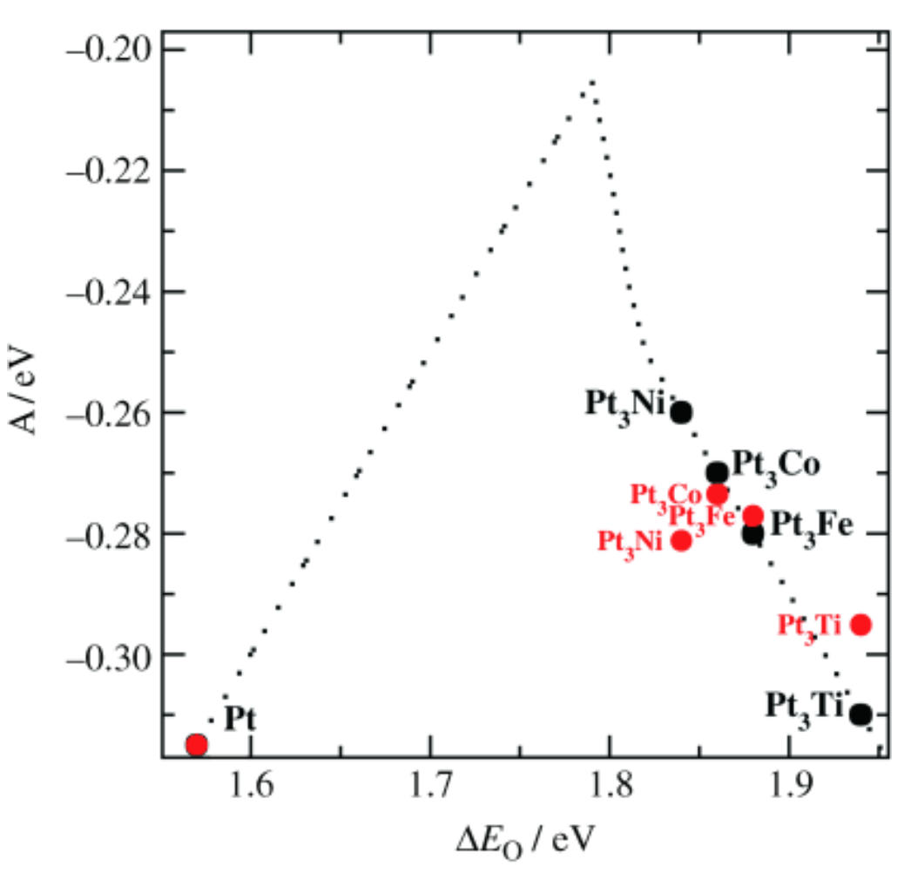
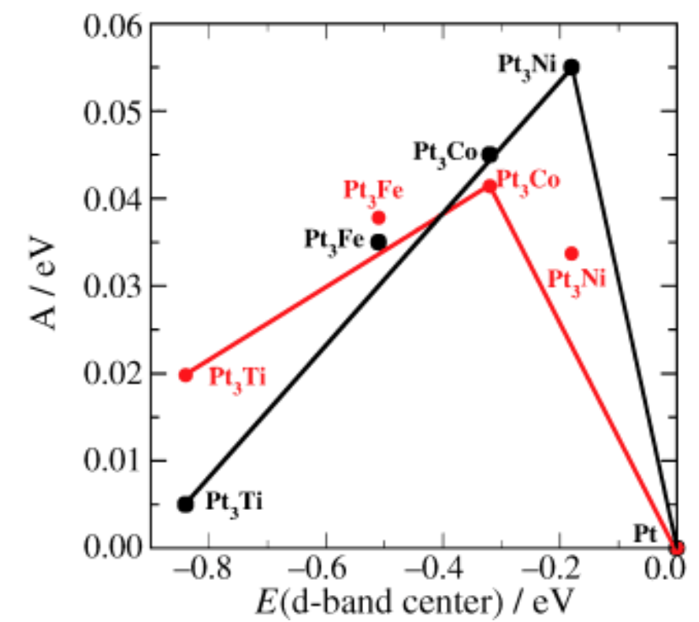
Tuning the Adsorption Characteristics
Changing the Electronic Structure
Stamenkovic V., Angewandte Chemie 118.18 (2006): 2963-2967.
Notes:
It was established that alloying Pt with 3d transition metals tunes the electronic structure to change the performance of an alloy for the ORR. The x axis represents the d-band center energy of various alloys with respect to platinum and y axis represents the activity. An Sabatier volcano type relation was observed.
Both these examples discuss separate methods for tuning the adsorption characteristics of the intermediates. This brought us to answer the question, can both these effects be studied simultaneously. The answer to this question was Intercalation materials.
Right figure higher res possible?

Slide 8
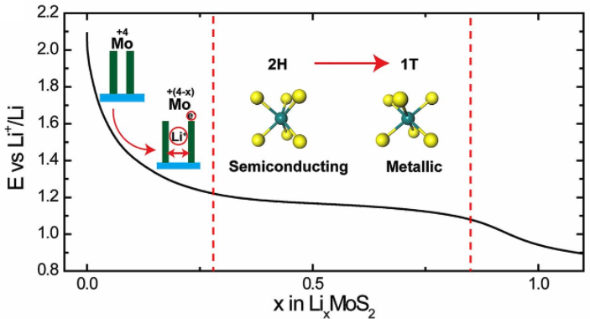
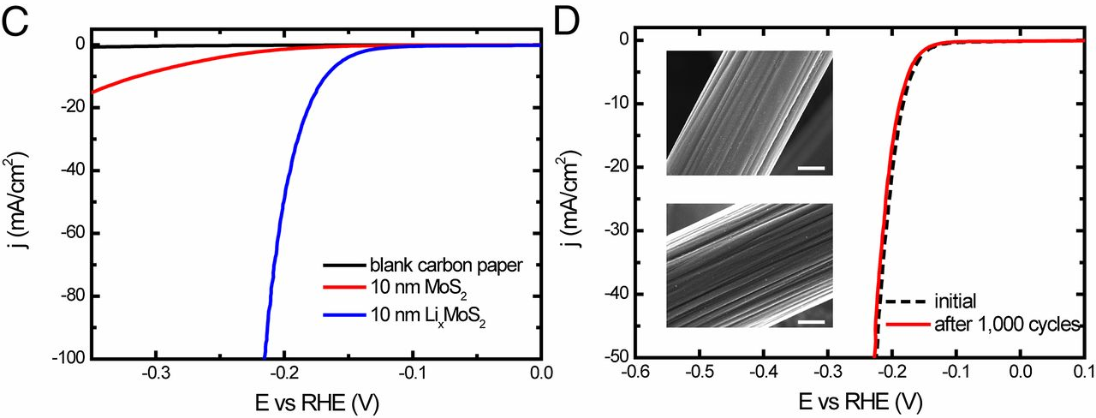
(De)Intercalation –To tune Activity
2D Layered Materials – emerging family of materials with tunable properties
Wang H. et. al. Proc. Natl. Acad. Sci., (2013) 110(49) 19701-19706
Notes:
1. As showed in the previous talk, Molybdenum disulphide, a 2D material with strong covalent bonding within the molecular layer and weak van der Waal’s interaction between the layers. Lithium intercalation into the van der Waal’s gaps of Molybdenum disulphide was used at Stanford to tune its activity for Hydrogen Evolution reaction, and some amazing results were obtained.
2. Intercalated Li causes expansion of the van der Waal’s gap and a change in the oxidation state of Molybdenum. This causes a phase transition in the material changing it prismatic structure to octahedral. As result the material transitions to a 1T metallic state from a 2H semiconductor state, causing the increased activity.
interesting – don’t use interesting – it might be interesting to you – also, interesting could be positive or negative. Use emerging instead.

Slide 9
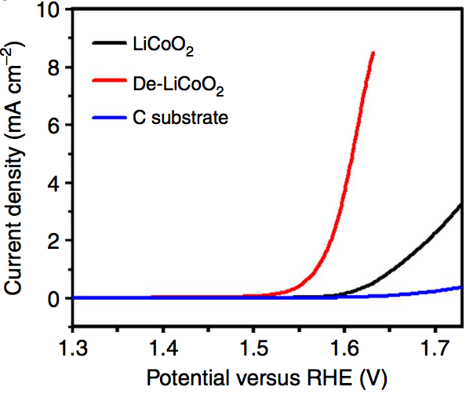
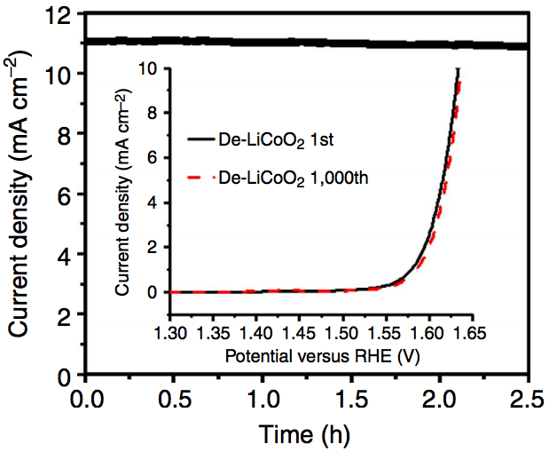
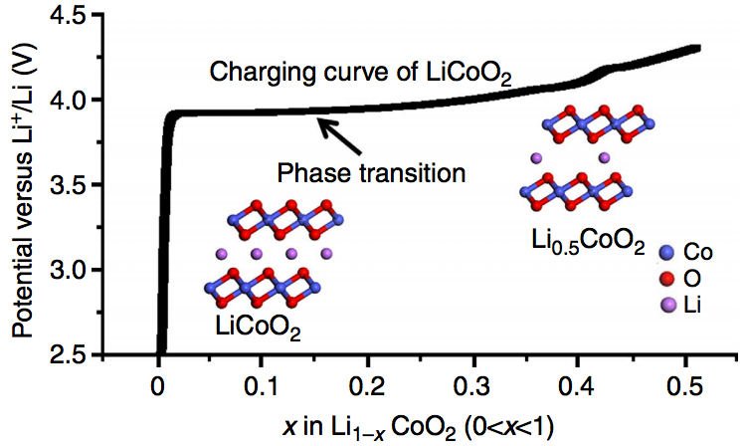
(De)Intercalation – Tool to tune Activity
Lu Z. et. al. Nat. Commun., 5 (2014): 4345
Notes:
Another example where intercalation induced phase transition was used to tune activity of host materials was shown by Lu at Stanford.
In contrary to the case of MoS2, they see that delithiation in LCO and other improves its activity for oxygen evolution.
The transition between LiCoO2 and Li0.5CoO2 happens between 3.9 and 4 V relative to Li+/Li electrode as can be seen the figure.
Once again the increase in the activity for OER can be ascribed to the
changed electronic structure → It is expected that the oxidation state of Co is not > 3 → which in turn affects the adsorption binding energies of the various intermediates involved in the OER reaction.
LiCoO2 – semiconductor and Li0.5CoO2 is metallic – more efficient charge transport through conductive surface in metallic delithiated LCO – benificial for OER activity.

Slide 10
Criteria For Catalyst selection
“Cathodic materials”
Potentially suitable for Oxygen Evolution
LCO , LMO , LFP , NMC, NMO, NCA etc.
“Anodic materials”
Potentially suitable for Oxygen Reduction
Graphene , MoS₂ , h-BN , M-Se₂ etc.
Stability
1. $∆G_{form}<0$
2. At the reaction potential, material should:
Not undergo phase transition
Not undergo decomposition
Notes:
These observations seem to follow a general trend. We want to propose our theory for a Criteria for selecting intercalation mateirlas as catalysts for various electrochemical reactions.
We propose that since Cathodic materials are stable at high oxidative potentials, they could potentially behave as OER catalysts. Hence LCO, LMO, NMC etc could be suitable for Oxygen evolution reaction.
Similarly, anodic materials that are stable at low reductive potentials, could be used potentially for Oxygen reduction reaction
A preliminary stability check step can be used to eliminate candidates of this list.
Pre-screening steps that we propose to include are:
Firstly, the formation free energy of the material should be negative
Secondly, at the reaction potential, the material should not undergo phase transition or decomposition.
If these conditions are satisfied, the materials could possibility used for catalyzing these reactions
With an end goal of screening intercalation materials for various reactions, we start first with Lithium cobalt Oxide.

Slide 11
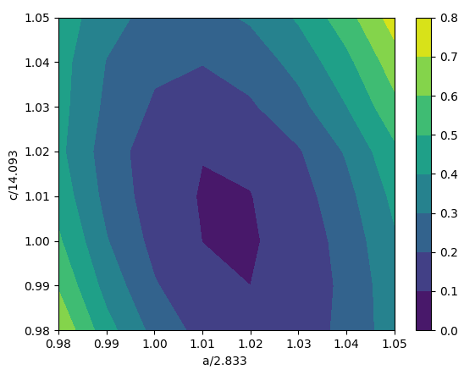
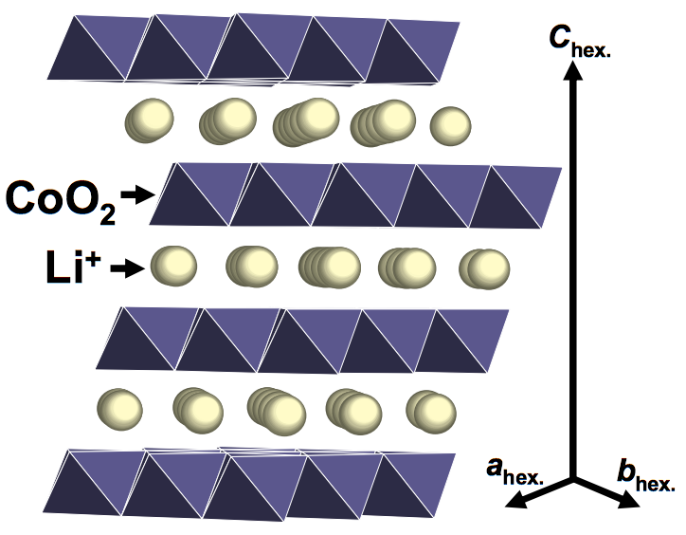
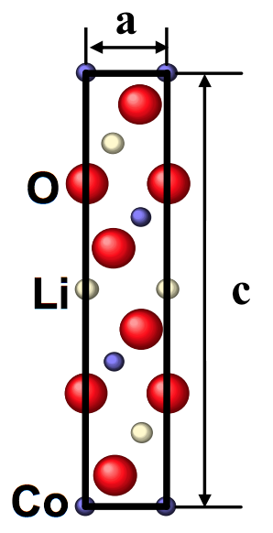
Lattice Optimization
Optimizing the bulk lattice of LiCoO₂ and understanding the effect of (de)litiation on the materials lattice parameters
 | c (DFT) | c (Experimental)
Li_{0.25}CoO₂ | 14.23 | 14.2
Li_{0.50}CoO₂ | 14.66 | 14.4
Li_{0.75}CoO₂ | 14.37 | 14.3
LiCoO₂ | 14.16 | 14.07
Lattice Optimization for LiCoO₂
Amatucci, G. G. et. al. , J. Electrochem. Soc., 143.3 (1996): 1114-1123.
Notes:
We optimize the lattice constants for all the different phases we have considered for Lithium Cobalt oxide.
As it has a hcp type of lattice, we optimize the 2 lattice parameters a (use pointer) and c.
To optimize the both the lattice, I create a mesh grid of a and c with a 5% positive and negative strain. The plot shows a contour of relative bulk energy as a function of the lattice parameters. Using this we find the optimized lattice constant that has maximum stability.

Slide 12
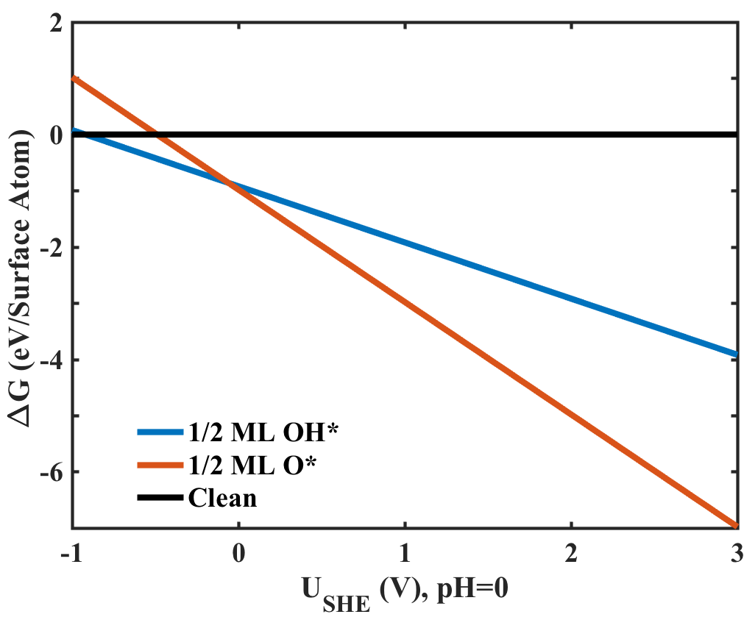
Pourbaix Diagram (LiCoO₂)
The free energy of a given surface as a function of the potential can be given as:
$$U=n∗θ ∗(ΔG_{rxn}(U=0)−U)$$
Where:
n = No. of electron involved
$θ$ = Coverage on the surface
Notes:
In order to map out the possible stable phases on the surface of the catalysts, we create a pourbaix diagram. The plot shows Free energy change per surface atom as a function of Potential referenced to SHE at pH=0.
As can be observed here (Pointer), we see that the surface is more stable covered with a half monolayer of OH and O than a clean surface. And for potential referenced to Standard hydrogen electrode above 0, we find the surface covered with half monolayer of oxygen is always stable.
These results are some of the preliminary results for the surface of Lithium Cobalt oxide. We are trying to further explore the more combinations of intermediates on the surface to get a more detailed Pourbaix diagram.
But these results help us understand that the surface in the reaction condition will always be covered with half monolayer of O. This result is in agreement with the results obtained by Michal Bajdich at Stanford.

Slide 13
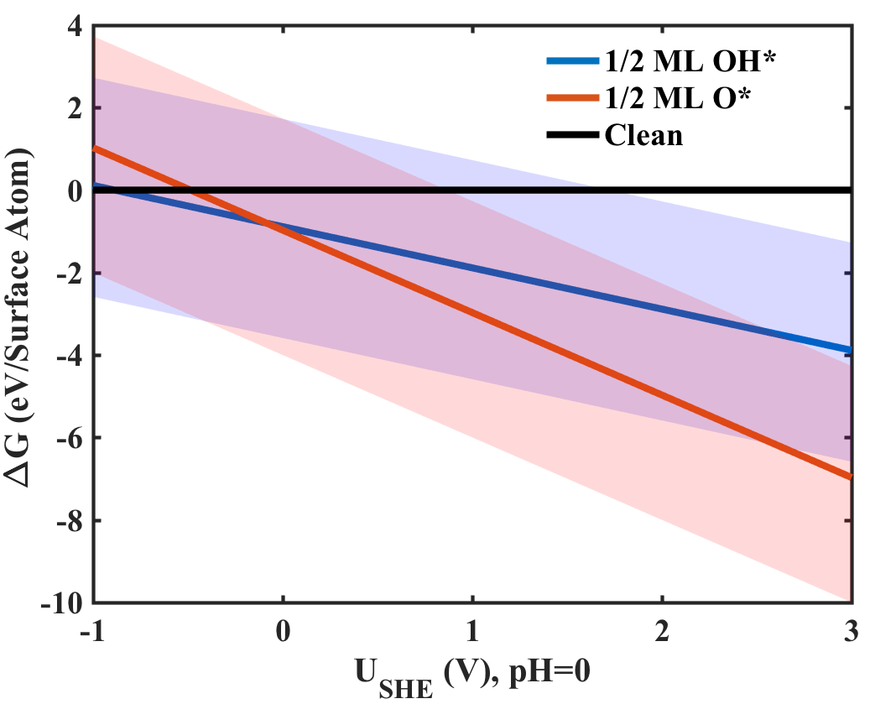
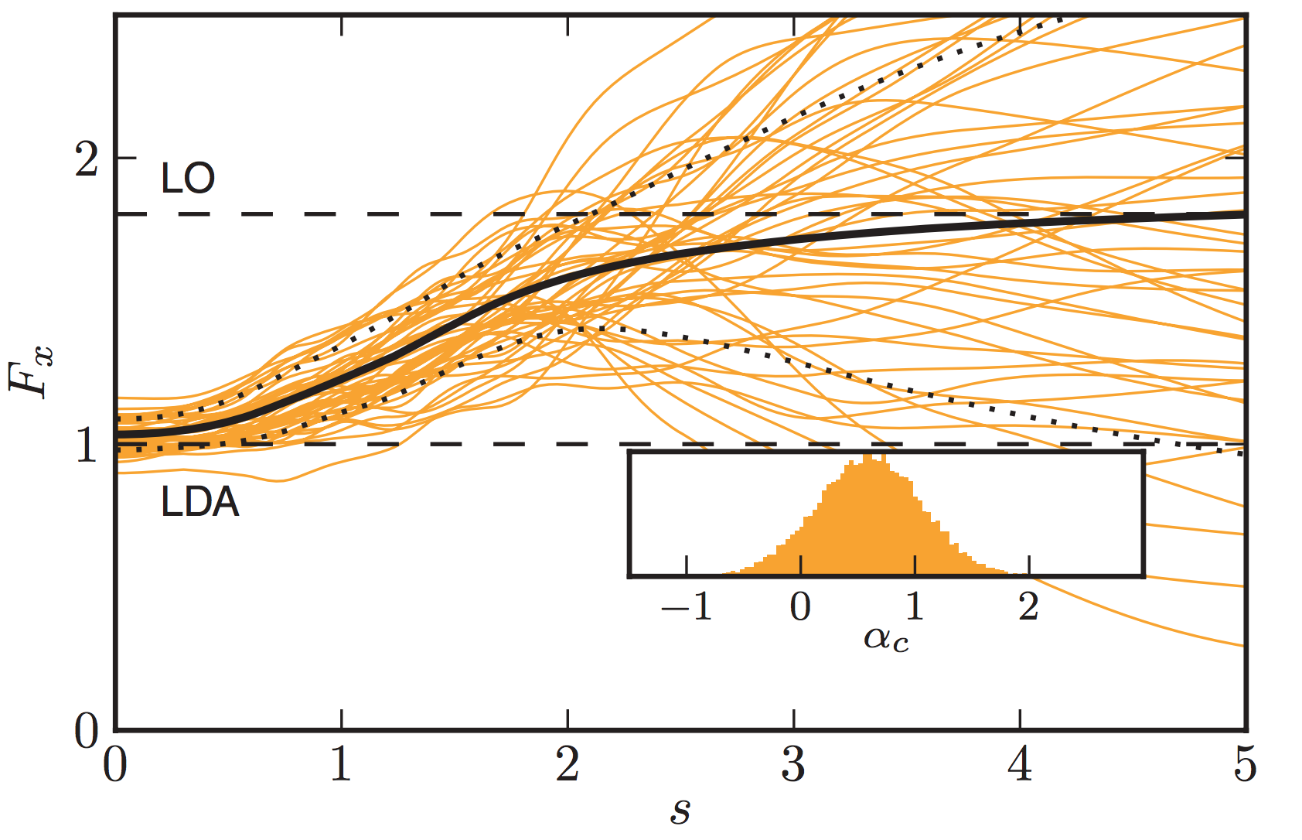
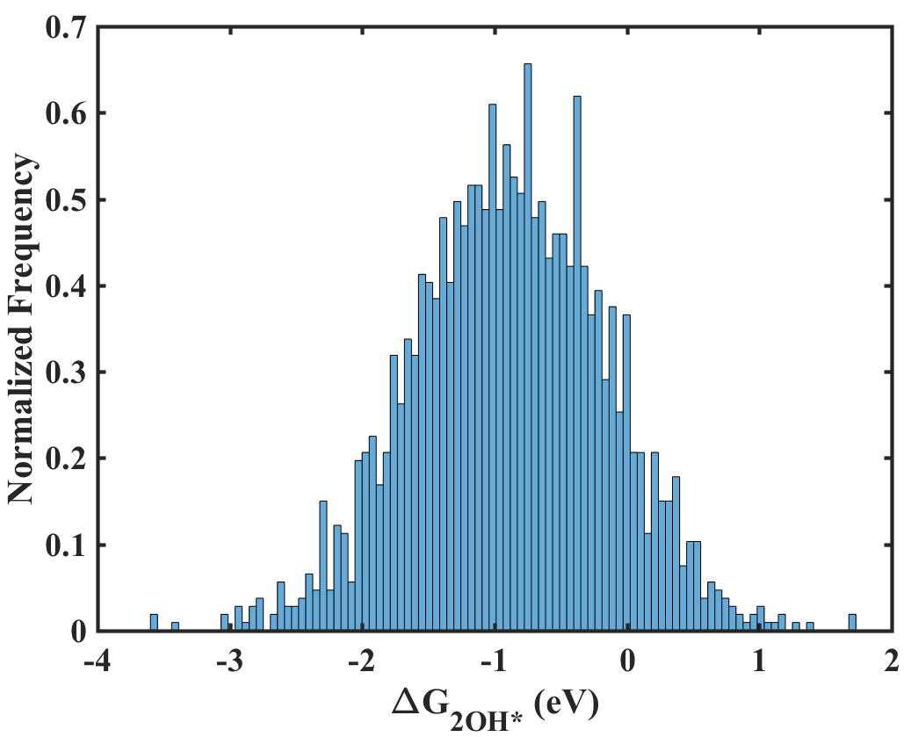
Uncertainty Quantification using BEEF-vdW
Wellendorff, Jess, et al., Phys. Rev. B 85.23 (2012): 235149.
Notes:
These pourbaix diagrams are routinely used to self-consistently determine the state of the surface, thereby calculating the adsorption free energies of the intermediates and the resulting theoretical activity of the catalyst. Given the importance of accurately identifying the surface structure, in this work we utilize error-estimation capabilities within the BEEF-vdW exchange correlation we utilize error-estimation capabilities within the BEEF-vdW exchange correlation.
The black line in the plot (pointer) shows the BEEF-vdW exchange enhancement factor as a function of reduced density gradient s, while the orange lines depicts the exchange enhancement factor for 50 samples of the randomly generated ensemble. Dashed black lines mark the exchange model perturbations that yield DFT results ±1 standard deviation away from BEEF–vdW results.
This implies that instead of one energy value calculated using DFT, now we have an ensemble of values. This gives us a way to quantify the uncertainties in these calculations. Here I am showing a histogram of free energy of half monolayer of OH on Lithium Cobalt oxide surface.
Hence in the pourbiax plot, instead of one line, we now have a ensemble of lines with different intercepts and same slope.
If we take a look any potential at this point, say U=0, each exchange correlation will determine a different stability configuration.

Slide 14
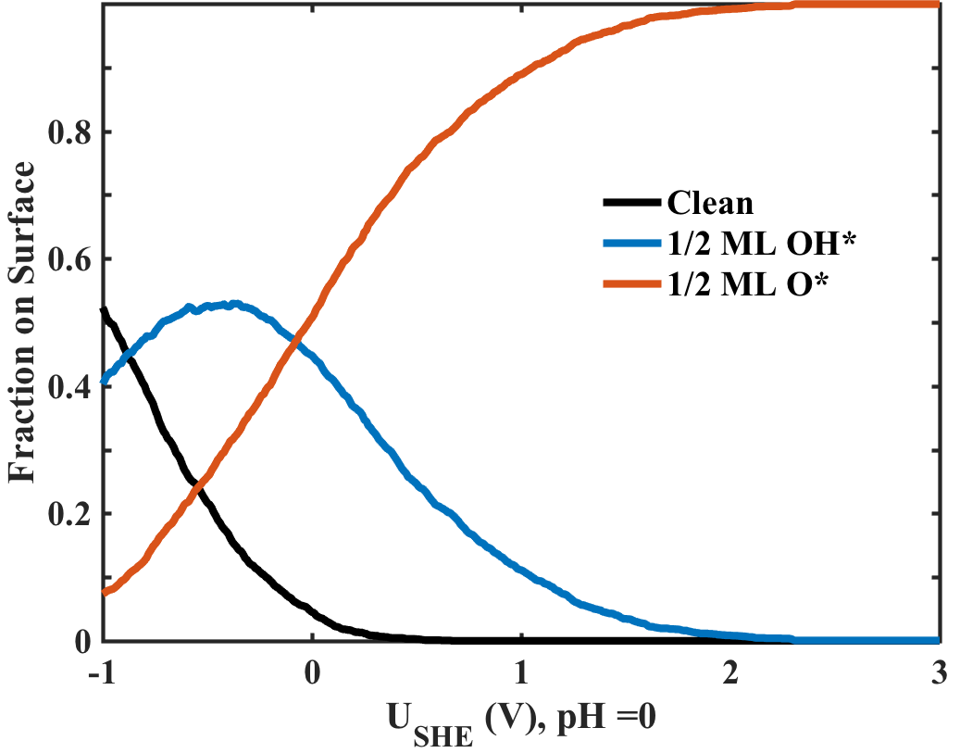
Probabilistic Pourbaix Diagram
Surface coverage prediction at U=0
 | Fraction on Surface (%)
Clean | 4.5
½ ML OH* | 44.8
½ ML O* | 50.7
Notes:
Hence by precisely knowing the number of functionals predicting a surface to be stable, we can plot a probabilistic Pourbaix diagram or a fractional predominance diagram. By incorporating the uncertainty, we now can say to a first approximation our prediction show that the surface is covered majority by half mono layer of O* i.e. about 50.7 % of the surface is ½ ML O*
Once again, these are just preliminary results, we are trying to look into more detailed calculations to understand the true nature of the surface.

Slide 15
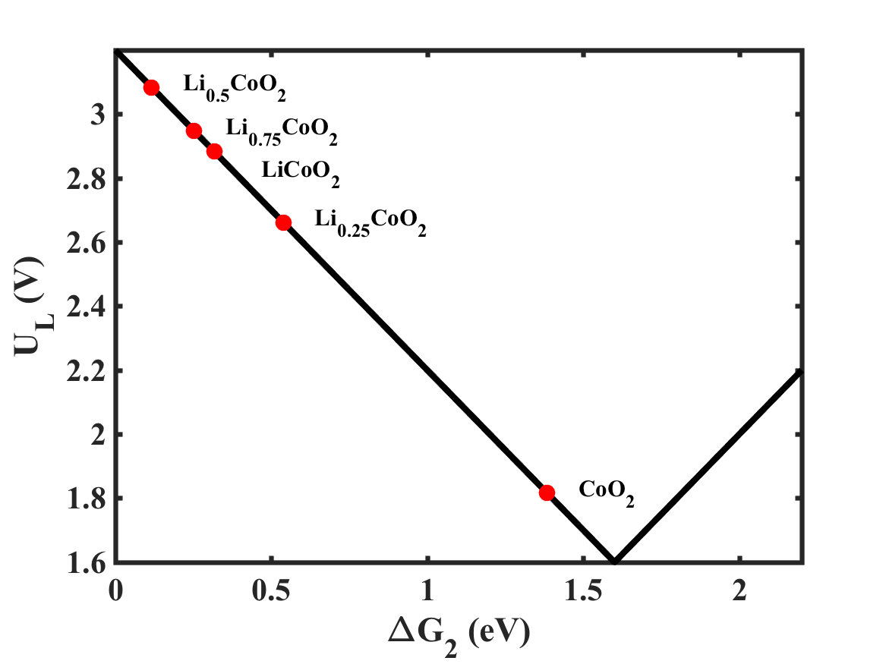
Activity Volcano
Notes:
Coming back to activity of these catalyst, here is the activity volcano that we get using our thermodynamic analysis. We have made an assumption that the surface is only covered with 1/4th mono layer of adsorbed species and the activity is not calculated self consistently using the Pourbaix plot. The absolute values of the overpotential would change, but we are hoping that we are correct in capturing the trend.
Cobalt oxide behaving as an really amazing catalyst is just an artifact of the way we have done our calculations. Once we have a detailed Pourbaix diagram for cobalt oxide and the other phases, we will be able to report the accurate activities.

Slide 16
Conclusion
Future Work
Intercalation materials can be the new direction to look for cheaper and high activity catalysts
We develop a new methodology to predict the surface structure incorporating the uncertainties obtained using BEEF-vdW exchange correlation.
Develop a thorough probabilistic Pourbaix Diagram for the various phases of Li_{x}CoO2 and understand its effects on activity.
Develop a general descriptor based approach to identify new for intercalation materials as catalysts for various electrochemical reactions.

